Slide 1

Square Application Usage Guide
Triage Team

Slide 2

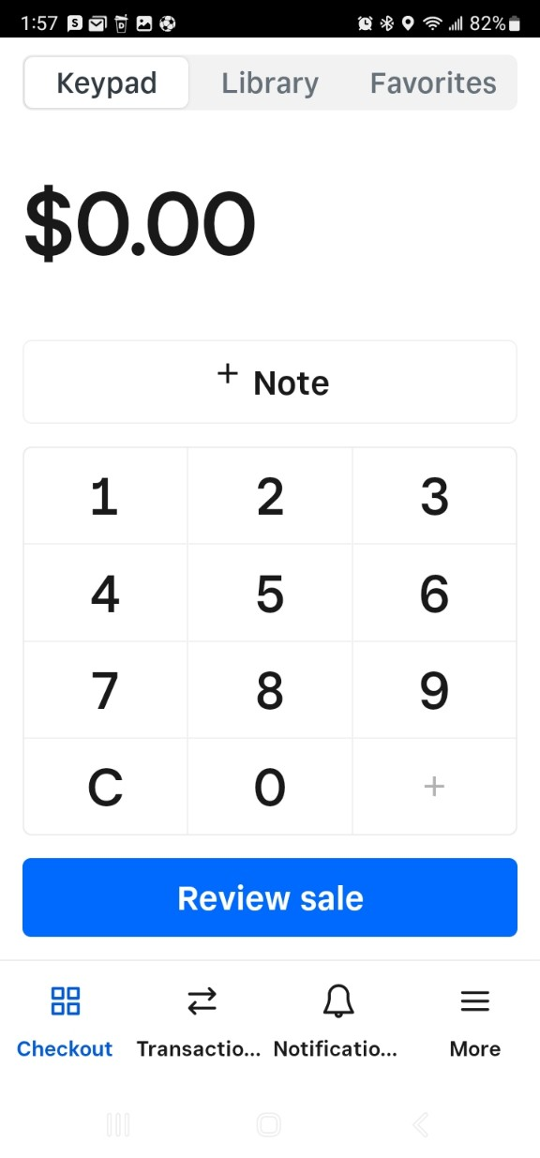
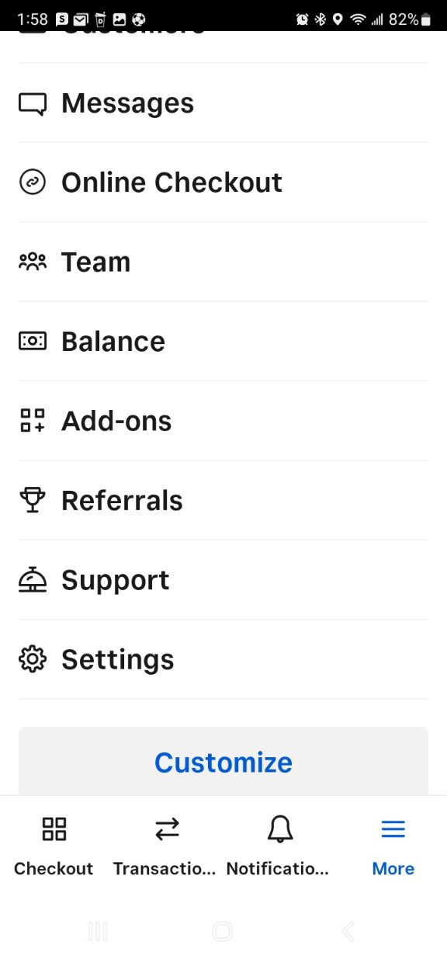
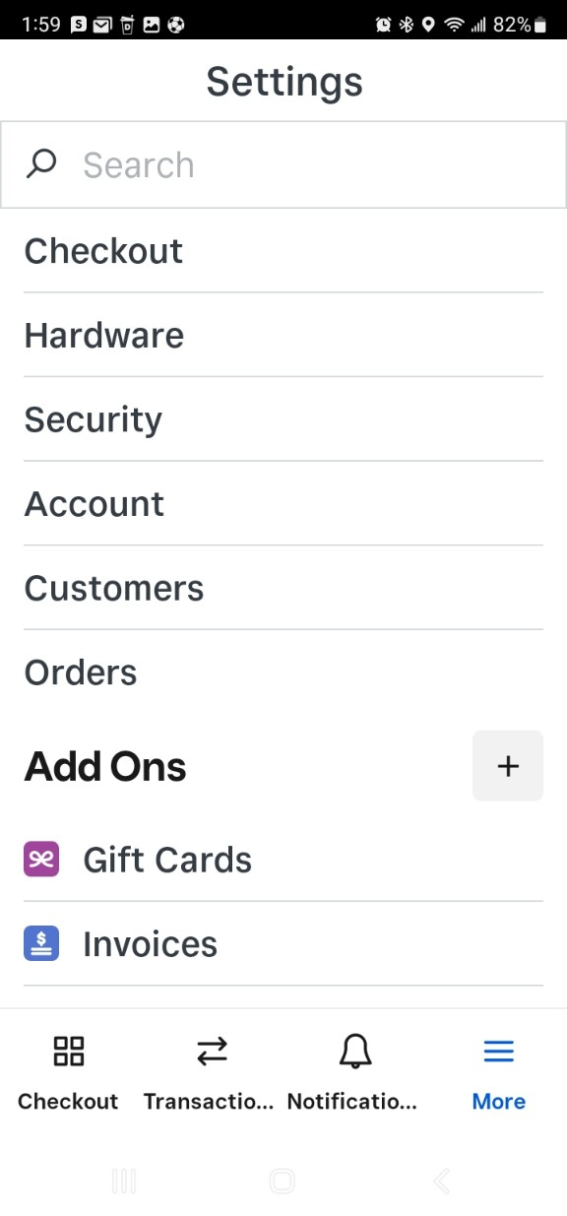


1. Touch “More”
1. Insert Device Name
2. Touch “Settings”
3. Touch “Hardware”

Slide 3
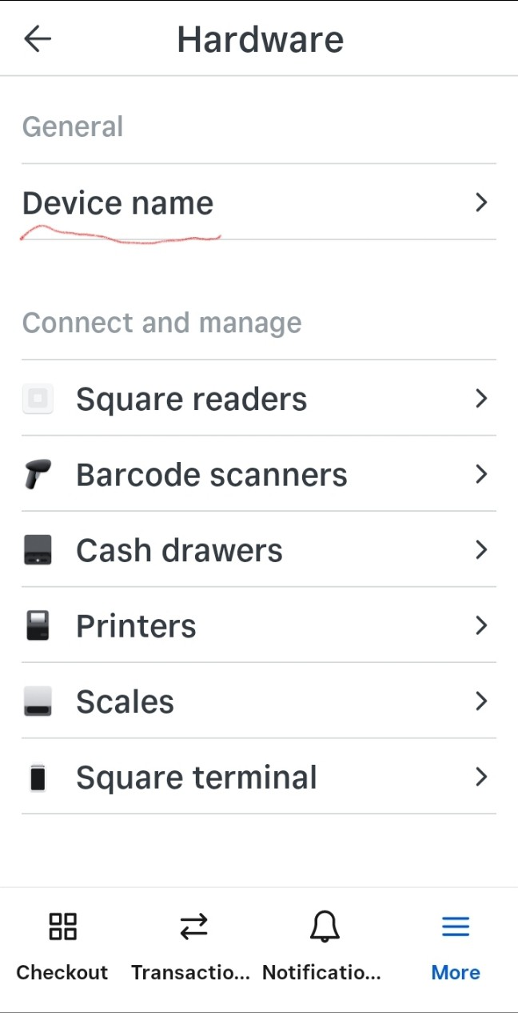
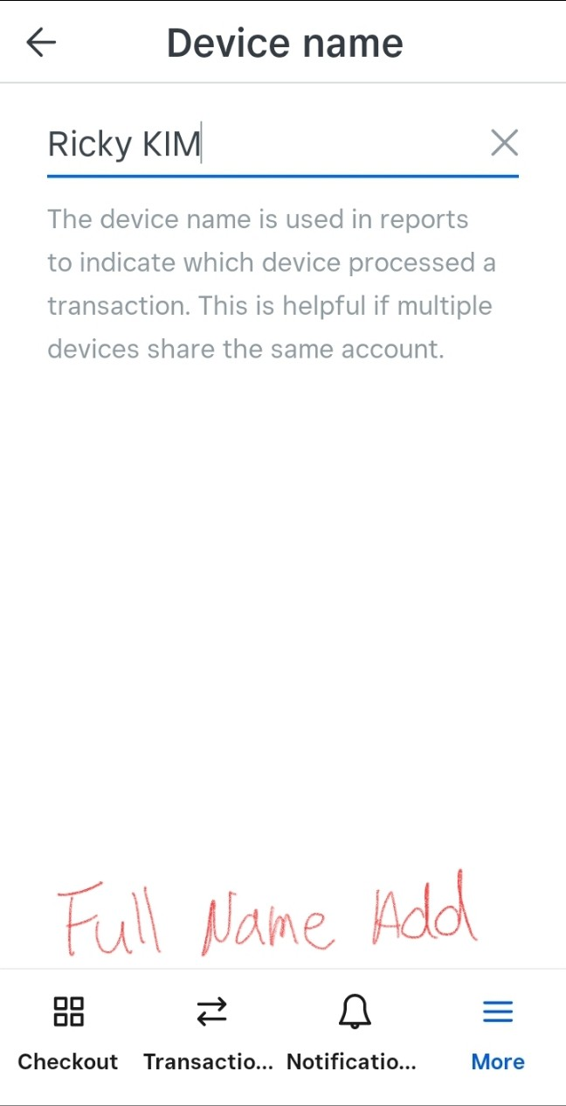

4. Touch “Device name”
1. Insert Device Name
5. Insert full name
Need to insert
“Your full name”

Slide 4
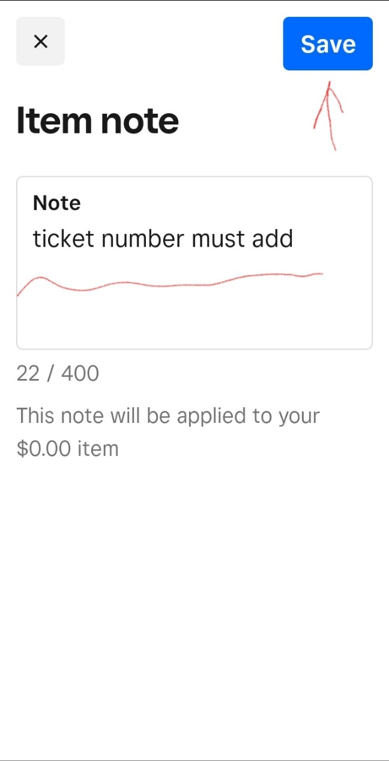
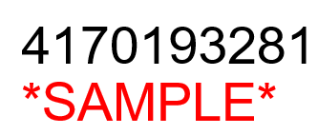
1. Touch “Note”
2. Insert Ticket #
2. Insert Ticket #
Need to insert
“Ticket Number”

Slide 5

1. Go to Square App
3. Initialize Tax Settings
2. Touch “More”
Scroll down and
touch “Settings”

Slide 6
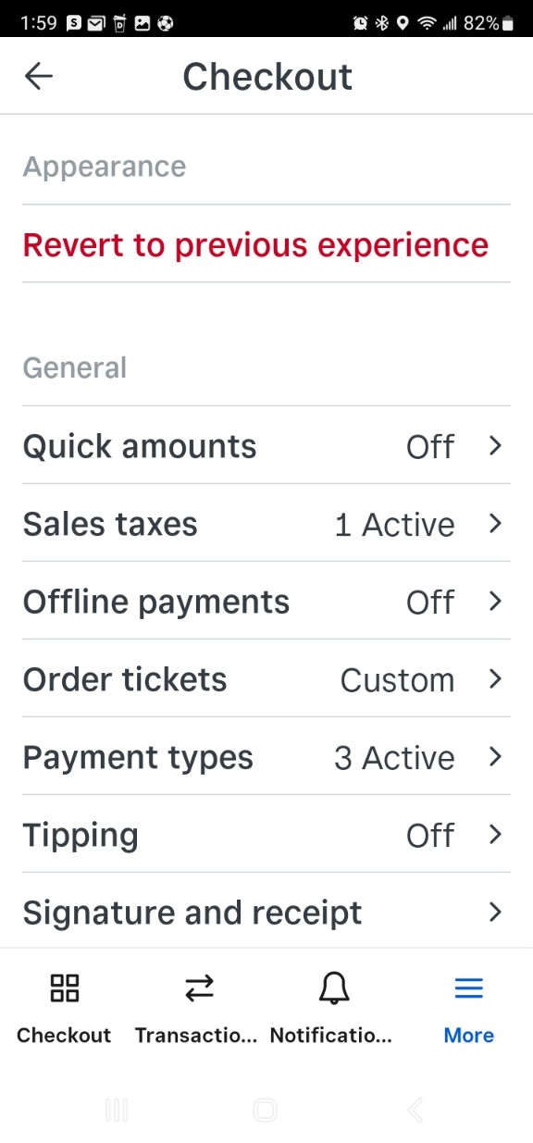
5. Check “Sales taxes” section
3. Initialize Tax Settings
4. Touch “Checkout”
If any sales taxes section is “Active” will manually calculate or amount plus tax !

Slide 7
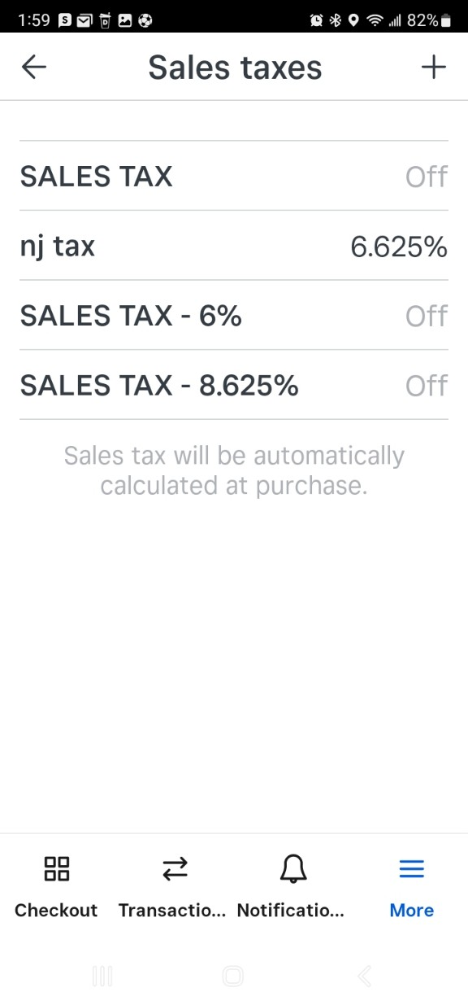
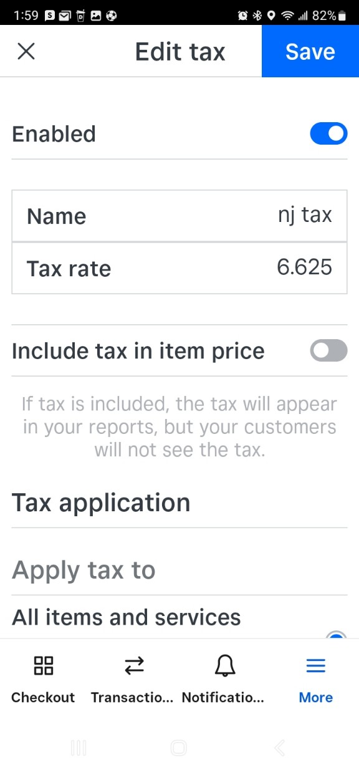


7. Turn off activated tax
3. Initialize Tax Settings
6. Touch activated sales tax
Touch “Enabled”
section bar and turn off.
2. Save it !

Slide 8


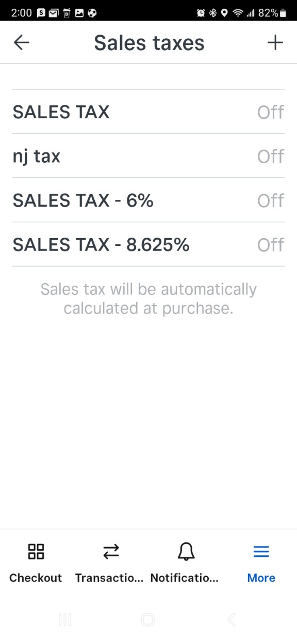
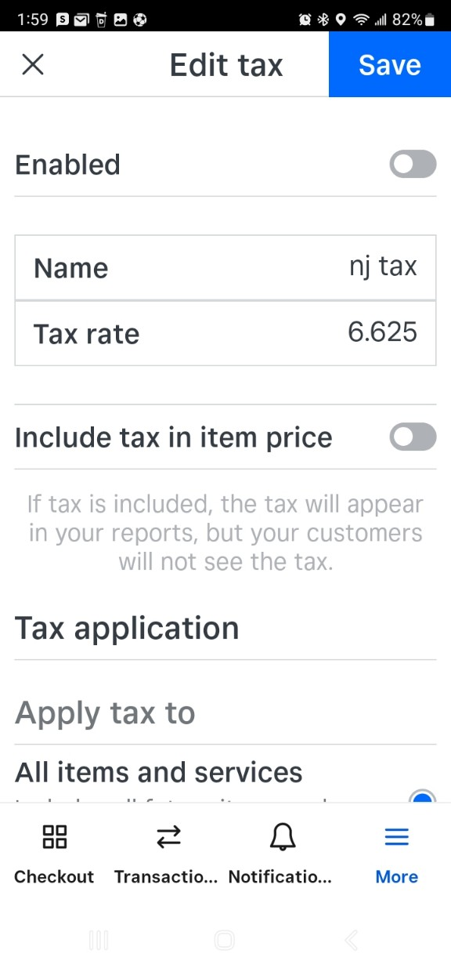

8. Check whether the tax status is “off”
3. Initialize Tax Settings
All Sales tax should be off !
Good to go now !

Slide 9
Tax rate per region
Region | Rate | etc
MA | 6.25% | Parts only
CT | 6.35% | -
NJ | 6.625% | -
PA | 6.00% | -
VT/MD/VA | 6.00% | Parts only
NYC | 8.625% | -
NYR | 8.00% | -
FLO | 6.00%
RI | 7.00%
Please use this chart to charge TAX properly by each region.
Everything should be calculated refer to this chart.

Slide 10
Television Service Fees & Home Appliance Rate
Trip ($120) + Labor + Parts + Tax
Size | Regular(Trip+Labor) | Panel(Trip+Labor)
Up to 49" | $ 190.00 (T120+L70) | $ 215.00 (T120+L95)
50-65" * | $ 210.00 (T120+L90) | $ 250.00 (T120+L130)
66-79" * | $ 260.00 (T120+L140) | $ 295.00 (T120+L175)
80" & up* | $ 410.00 (T120+L290) | $ 1,000.00 (T120+L880)
Monitor | $270 (T120+L150)
This is TV rate per size of TV.
We as HSN, charge TV and OOW differently.
Please be aware !!!
HA
HOME APPLIANCE FLAT LABOR RATE: |  | $120 Initial Trip / Diagnostic + $95 Labor => $215
MAJOR DRUM FLAT RATE: | $380 (120+160) | ONLY APPLICABLE FOR WASHERS [INCLUDES EXTRA MAN, > 2 HRS] / FLEX WASHER
OTHER APPLICABLE EXTENSIVE LABOR RATE: | $320 (2 HRS LABOR MIN: $120+200) | ICE BUILD-UP : TECHS PLEASE ADVISE CX TO MELT ICE PRIOR ARRIVAL
 |  | DISHWASHER: SUMP REPLACEMENT
 |  | GAS OVEN: GAS / SAFETY VALVE
 |  | REFRIGERATOR: LEFT DOOR [ALONE IS 1 HR] + ADD 'L DOORS
This is Home appliance labor rate.
Will get labor refer to the chart.

Slide 11
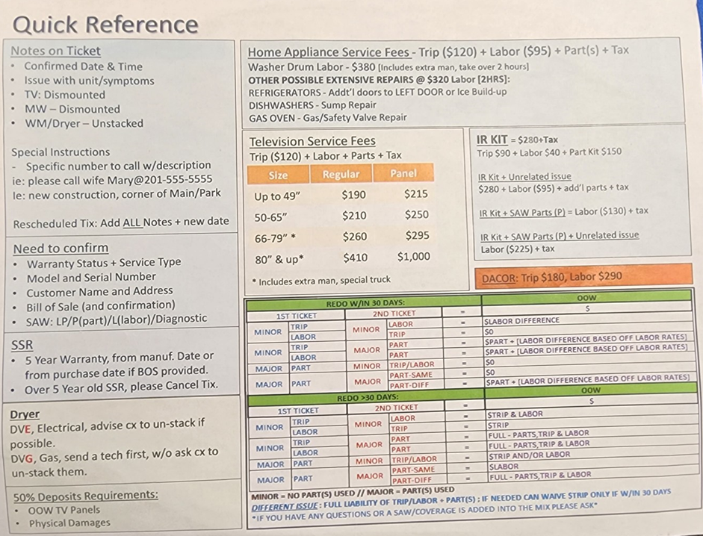
Quick Reference

